Slide 1
Voya Financial
Presents
Managing Your Portfolio
With
Confidence
Ripple Leung
Financial Advisor
Notes:
Welcome to our Appreciation Event

Slide 2
Voya Financial
The World's Most Ethical Company® designation recognizes those organizations that have had a material impact on the way that business is conducted by fostering a culture of ethics and transparency at every level of the company. This is the second consecutive year that Voya was selected for this honor.
Notes:
This is the first event we host since the name change from ING to Voya – a departure from the Dutch company. Voya is truly US based financial firm – trading on the US Stock Exchange with a market cap of 9.75billion.
We want you to know we hold the highest standard in serving our clients ethically and professionally. At best, we don’t over promise or under deliver.

Slide 3
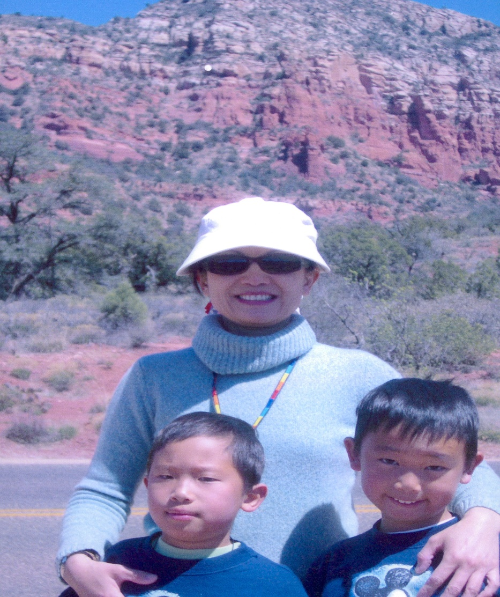
Ripple Leung
Financial Advisor

Slide 4
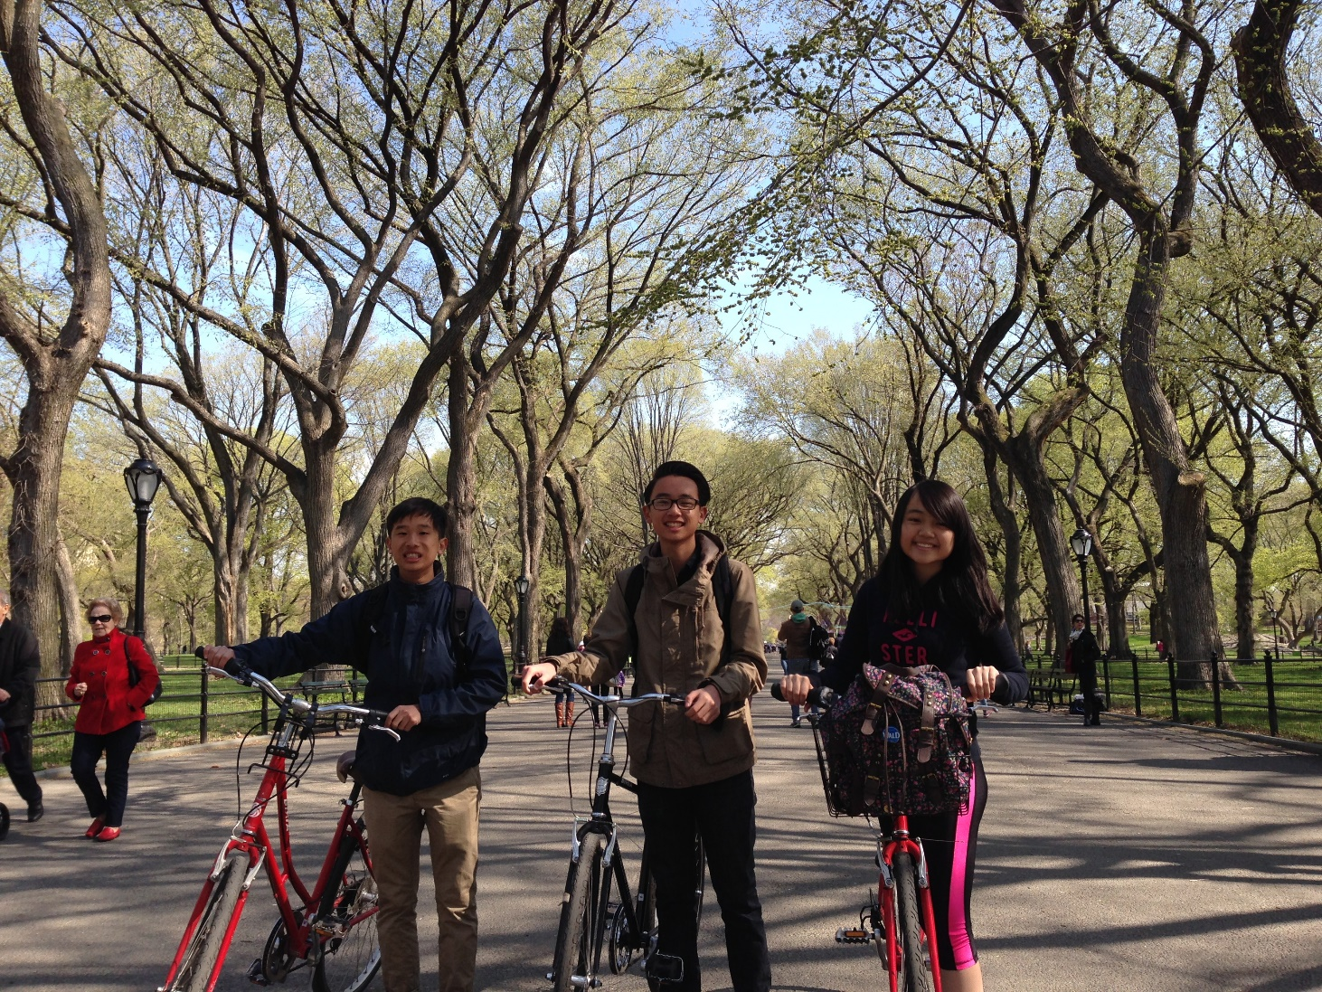
Ripple Leung
Financial Advisor
Licensed and trained by Morgan Stanley, Series 7, 66, 31, & Life Insurance
Joined Voya and became an Independent Financial Advisor since 2006. Chartered Retirement Planning Counselor in 2016
President (2008) and Treasurer (2006-2013) of Fremont Asian Lions Club
Mother of twin boys
Notes:
As some of you know my humble beginning start at Morgan Stanley, I got trained and licensed there. I joined ING and became an independent FA. That way it enable me to fully engage to what is right for the client instead of taking care of corporate interest.
Other than being a single parent raising a pair of twin boys, the girl in the picture is my niece who is living with me over the last two years, I also volunteer a lot in the community.

Slide 5
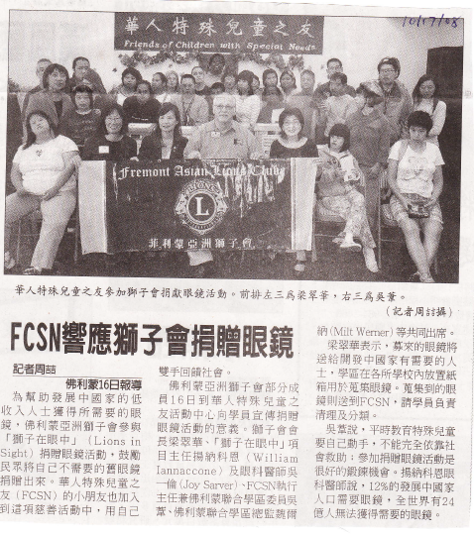
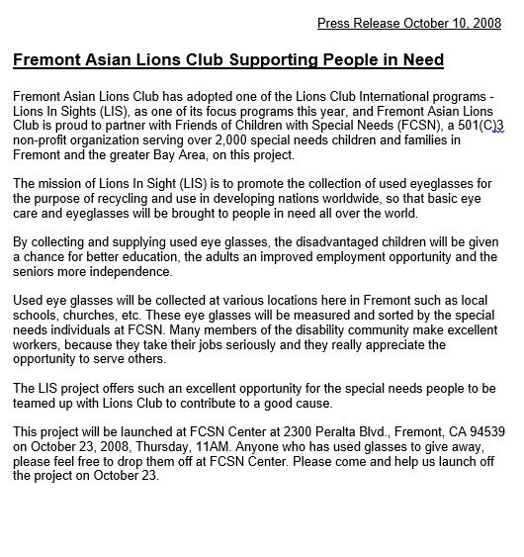
Ripple Leung
Financial Advisor

Slide 6
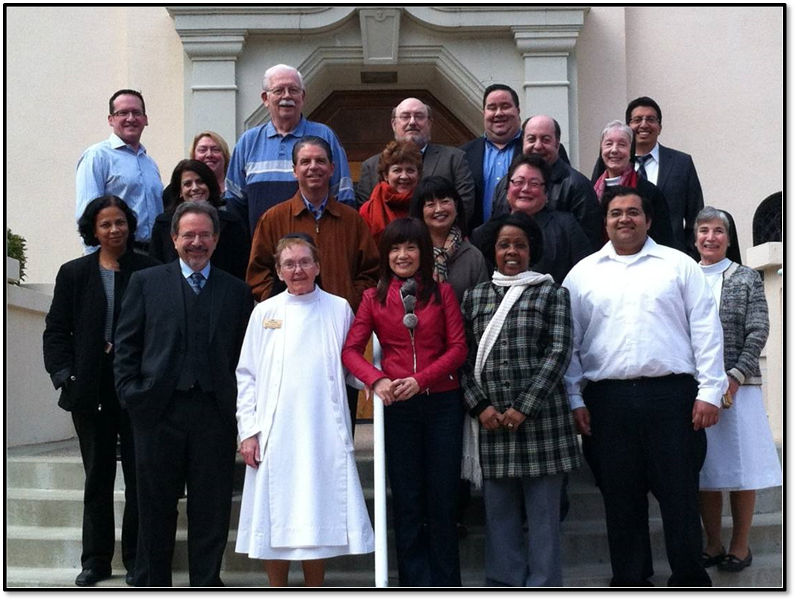
Current Public/Community Service
2011-2012 Human Relations Commissions
2012-2018 Planning Commissions
Notes:
When I first immigrate here, I had a chance to volunteer at the local community club and I found my passion of making a difference in the community. The key reason was I wanted to proved being new to the country doesn’t mean we are underprivileged and cannot help others. This still holds true today that I support and donate part of the income (10% last year) to underserved communities on top of tithing at my church This is how I differentiate myself from others. Think of others more than myself and always ready to help.
Through the community activities, I got to know the city leaders, I was appointed to be HRC and now in Planning Commission by two different mayors.

Slide 7
The Team
Notes:
Enough about the personal side of me.
I worked closely with one of the co-worker Daniel Loy in the Bay area as well as I also belong to an extended team.
As you can see we are truly a very diverse team here.
Voya has over 3000 Advisors across the country and our back office is in the mid-west as well as east coast.

Slide 8
Introduction of an Elite team Center Pillar Wealth Management
P- Passion for Excellence
I- Integrity
L- Lifetime Learning
L- Leading By Example
A- Accountability
R- Respect for Others
Notes:
This year at Voya , we become part of elite team - Center Pillar Wealth Management.

Slide 9
Timeline for the CalABLE Program
Prior to 2013, a person with a disability was not able to save more than $2,000 without their SSI being suspended.
2014, Obama signs Achieving a Better Life Experience Act.
2015, California passed SB 324 which implements the ABLE program.
2016, CalABLE began discussion of program operations.
January 2018, CalABLE starts.

Slide 10
Who is Eligible ?
ABLE accounts are available to U.S. citizens and permanent residents who can legally own securities, including individuals who are blind or disabled from a condition that began prior to age 26.
Those who meet the age requirement and may be eligible for SSI or SSDI benefits because of their disability.
Individuals with a written, signed diagnosis from a licensed physician.

Slide 11
Who acts on the Account
Account owner = Beneficiary
Parent
Court-appointed guardian or conservator
Attorney-in-fact acting under a Power of Attorney

Slide 12
Who can contribute
Anyone can contribute to an ABLE account, including:
Parents
Grandparents
Extended family
Friends
Beneficiary
Charity/trust

Slide 13
A tax-free saving

Slide 14
Qualified Disability Expenses

Slide 15
Center Pillar Wealth Management Central Strategies
Wealth Management Platform
Variable Annuities
Life Insurance
Non-Traded REIT & BDC
Notes:
In the financial world there could be complicated in terms of a variety of different investment vehicle. We primarily a group focus on financial planning and retirement services.
This pie attempts to put things in a simplified format.

Slide 16
Financial Planning
Notes:
What is Financial Planning??
In the world of Financial Planning,
There are two main approaches…
Either cash flow or goal based.

Slide 17
Why do I need Financial Planning?
Have a Direction
Gain Certainty
Know what you need to Focus – Work/ Save/ Invest
Have a Peace of Mind
Focus on What’s more important – Health/ Family & Friends
Notes:
What is Financial Planning??
In the world of Financial Planning,
There are two main approaches…
Either cash flow or goal based.

Slide 18
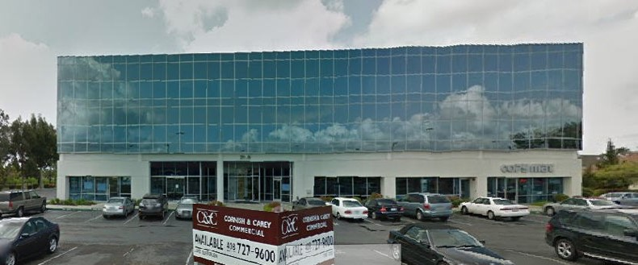
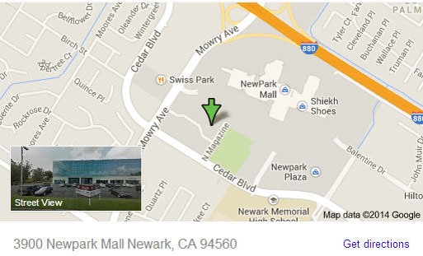
East Bay Branch Office
3900 New Park Rd., 3rd Floor,
Newark, CA 94560
Notes:
What is Financial Planning??
In the world of Financial Planning,
There are two main approaches…
Either cash flow or goal based.

Slide 19
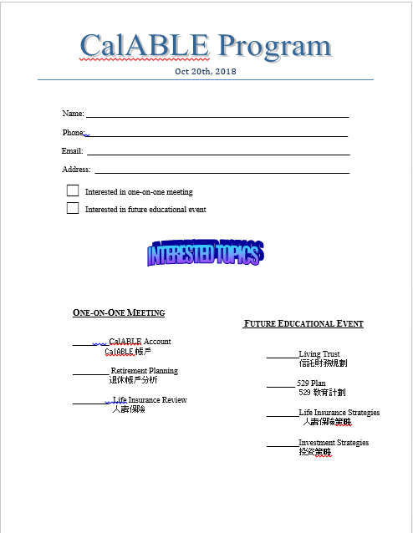
Notes:
What is Financial Planning??
In the world of Financial Planning,
There are two main approaches…
Either cash flow or goal based.

